Slide 1


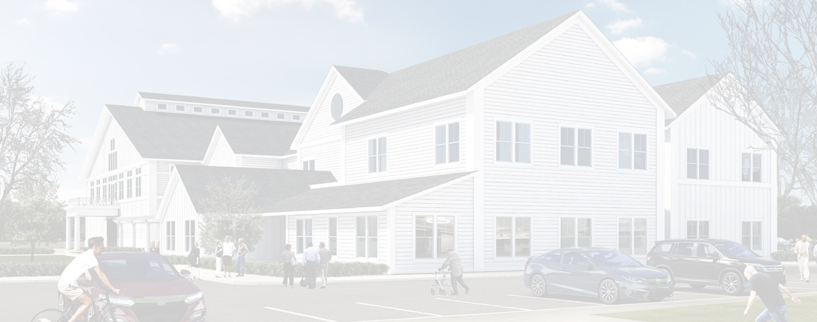
TOWN OF PEMBROKE
NEW COMMUNITY CENTER
Select Board Update | June 22, 2022

Slide 2
Design Update
Floor Plans, with “flipped layout”, finalized April
Audio/Visual scope and layout finalized April - June
Security Plan, scope and layout finalized May - June
Tel/Comm Plan, scope and layout finalized May - June
FF&E scope, layout, and budget finalized June
Final Design Reviews June - July
Finalize alternates and incorporate into design June
100% Construction Documents Complete July 15th

Slide 3
Project Schedule Update
General Contractor/sub-contractor Prequalification: June 2nd – July 1st
Permitting/Planning Board Approval: June – July. First hearing 6/13. Next 6/27
Finalize FF&E, AV, Security, Technology Design & Budgets June-July
Bid Documents available: July 20th *
Bidding: July – August. GC bids due 8/24.
Public Outreach with Project Update: August 2 (tentative)
Finalize Overall Budget with Low GC Bids: August 26 (tentative)
Public Outreach with Project Updates: August 23 (tentative) or early Sept.
Special Town Meeting to Vote on Overall Project Cost: September 13 **
Award Contract mid/late September
Start Abatement / Demo: October
Start New Construction: late October (at the earliest)
Construction Complete (14 mos w/ abate & demo) December 2023
* Bid docs contingency upon completion of permitting July
** Town Meeting Date TBD

Slide 4
Project Budget Update
Construction Market $/SF:
Senior Centers/Town Halls: $575-675/SF
School Construction: $600-750/SF
Public Safety Buildings: $650-760/SF
Market cost increases due to increase in steel; roofing; and MEP costs. All other costs level.
Added Hatch drive to base; and increase to fuel and site electrical costs.
Irrigation cost included in Town Green improvement cost.
Hatch drive included in site cost above. It is now the only entrance.
Total cost variance; proposed plan is to get a hard bid (targeted for 8/24) to finalize the cost, then determine the request for additional funding

Slide 5
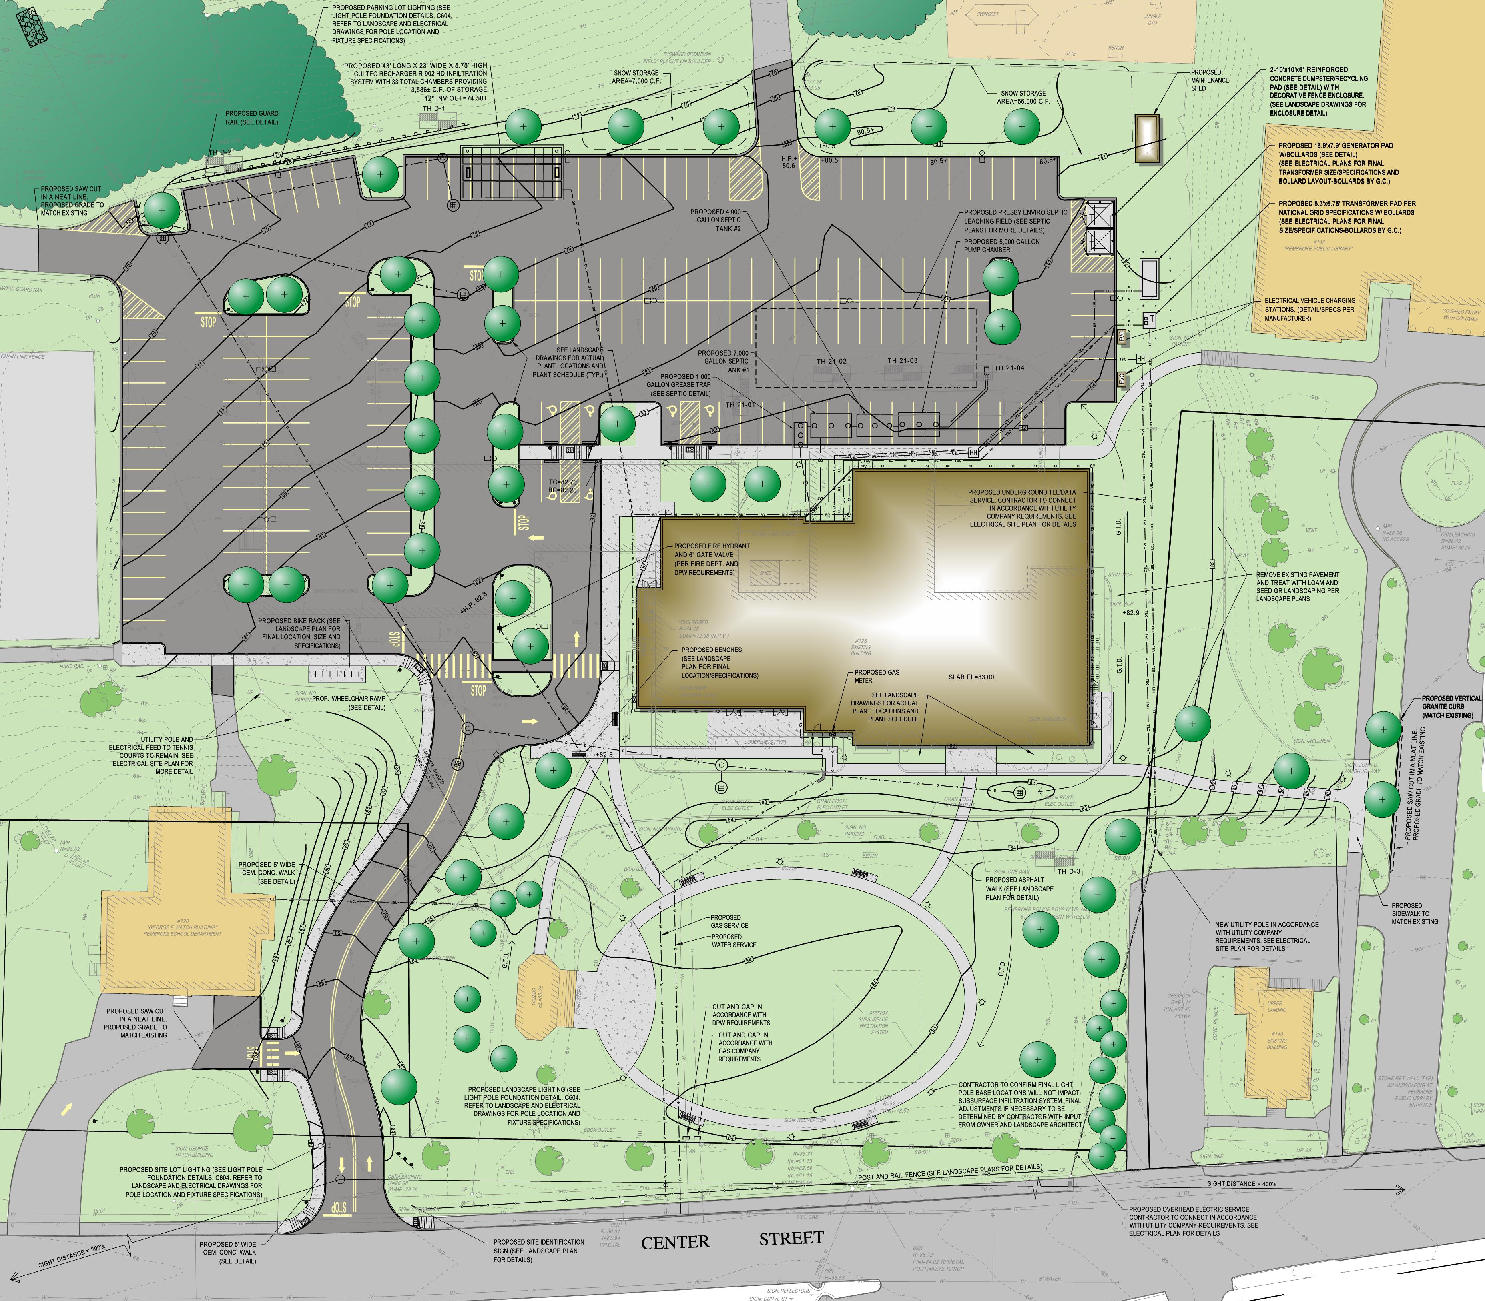
Design Update

Slide 6
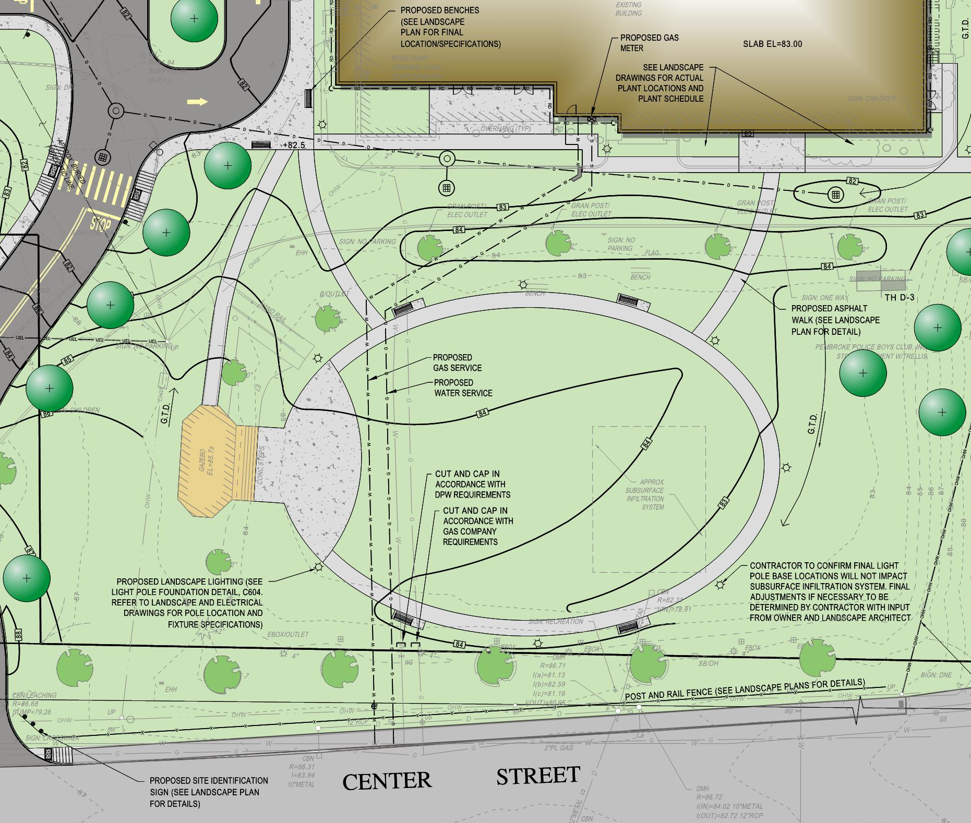
Design Update
Potential Add Alternate
Town Green – approximate value $250k
Base bid includes lawn only and accessible walk to bandstand. The Add Alternate adds:
  Oval asphalt walk and connecting walks to building
  Concrete pavement adjacent to existing bandstand
  Backed benches (4) on concrete pads
  site lighting poles (7) and fixtures and power
  Irrigation
  Plantings (trees/shrubs)

Slide 7
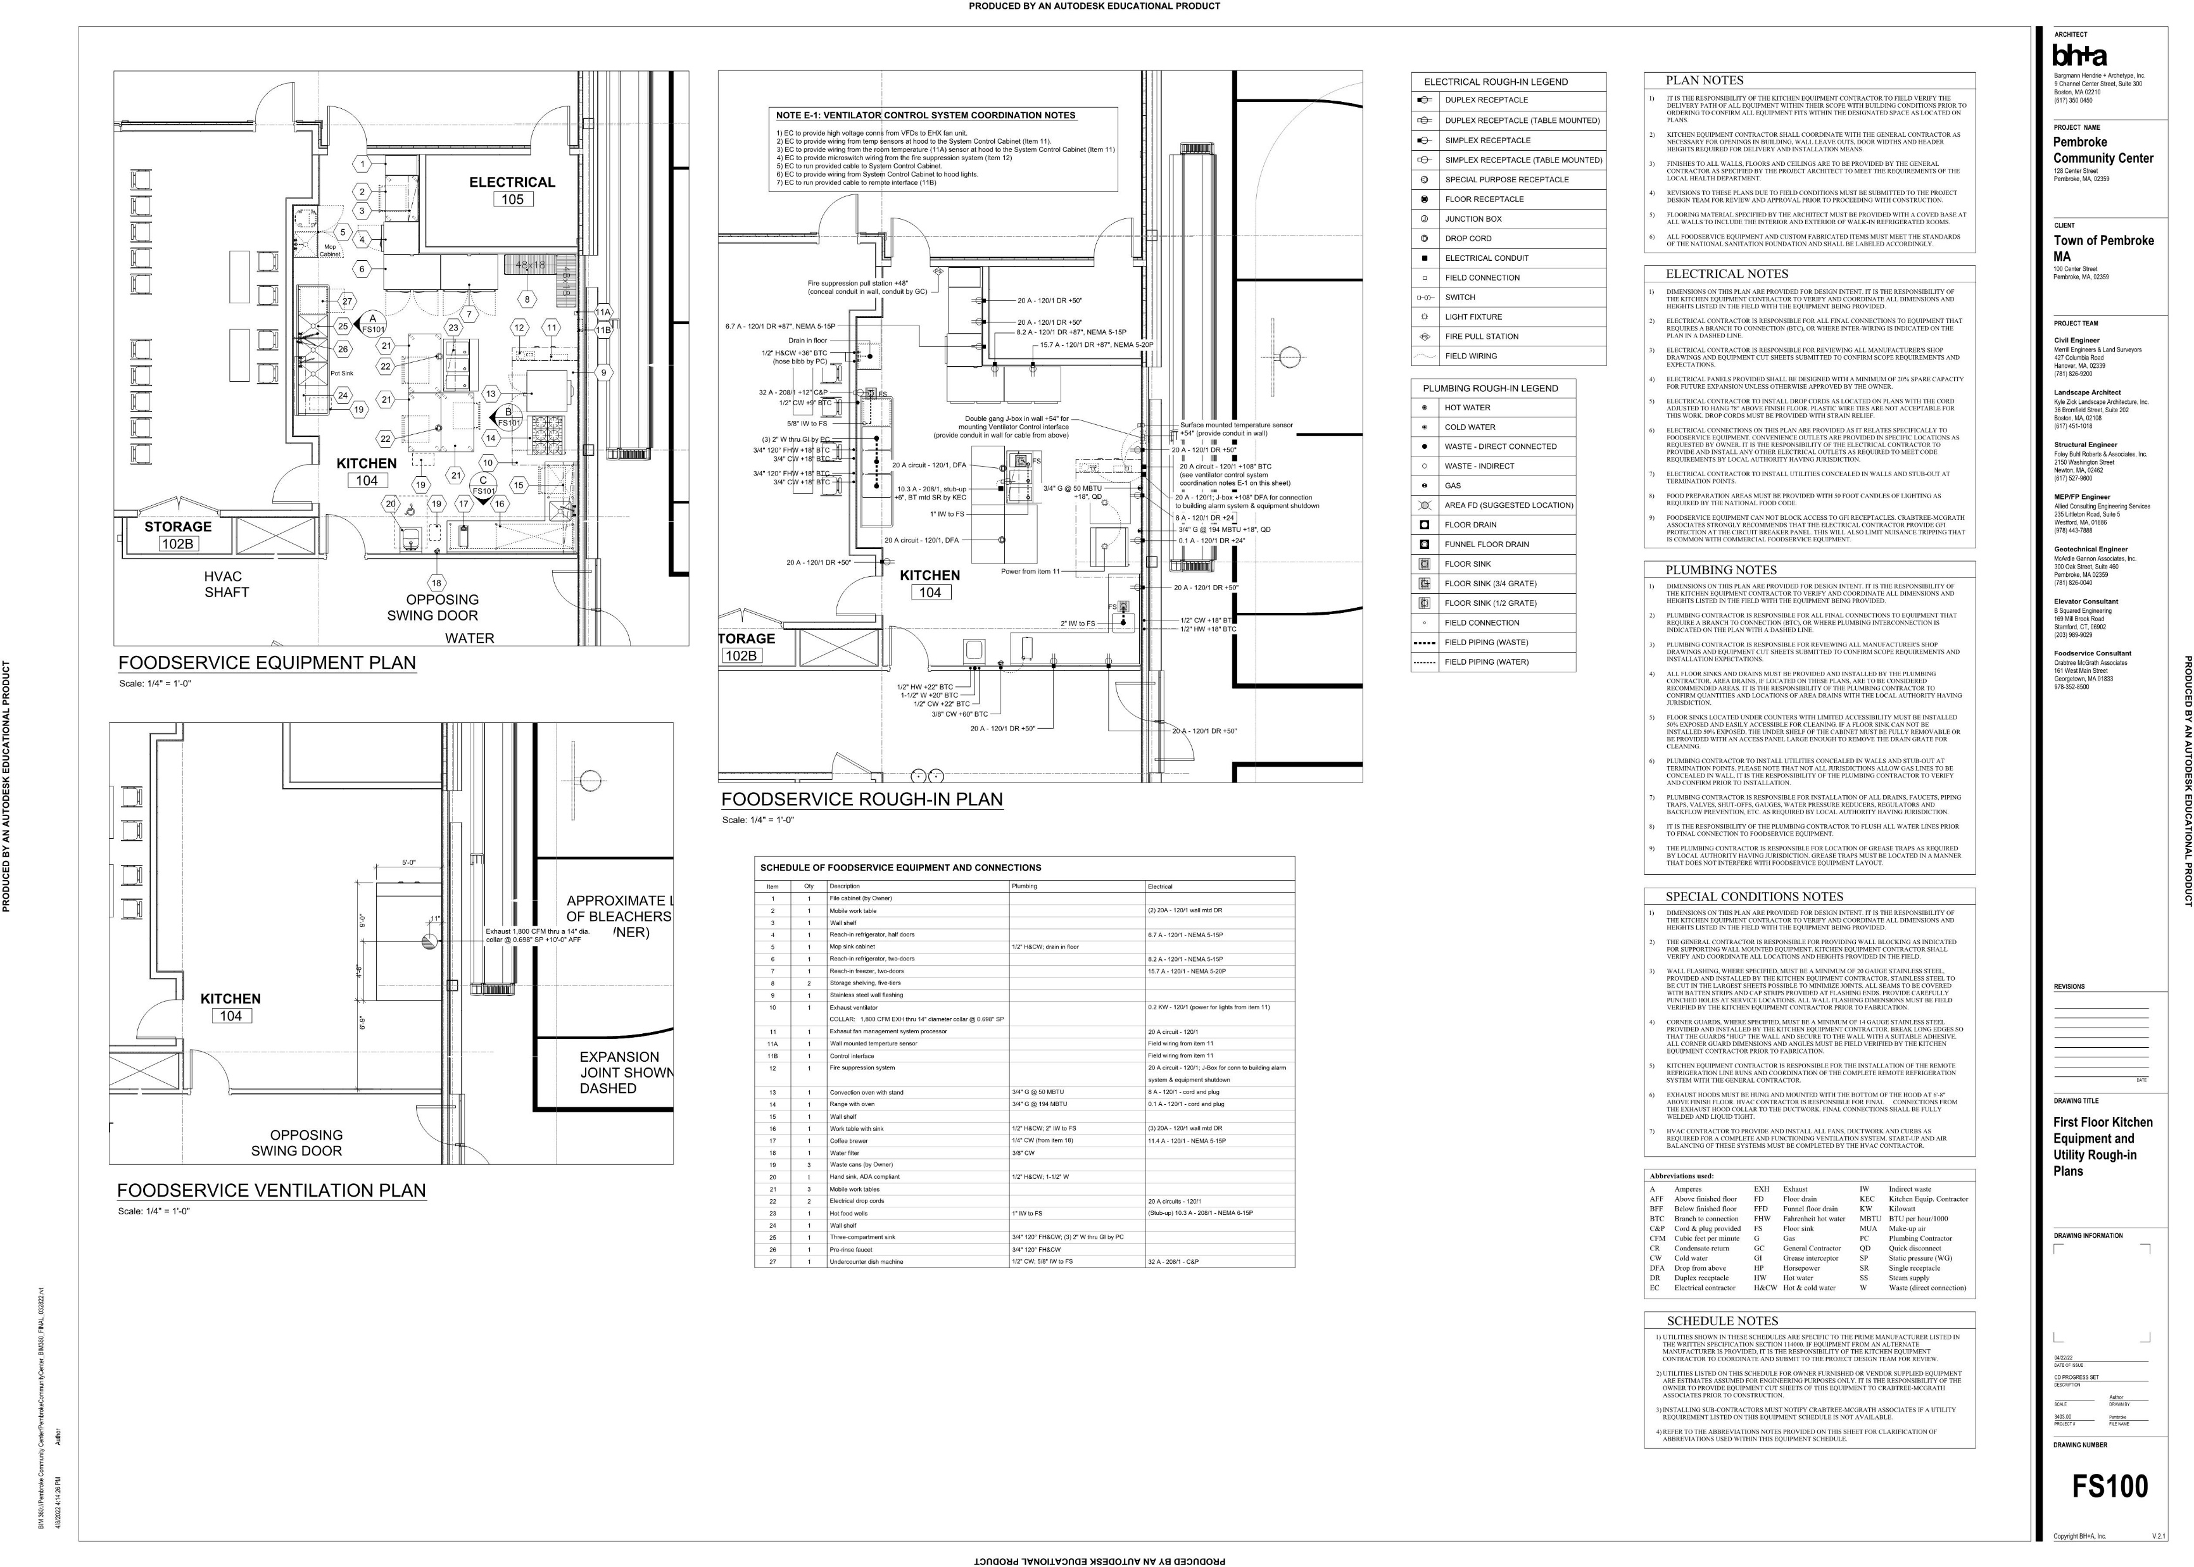
Design Update
Potential Add Alternate
Kitchen Equipment – approximate value $175k
Base bid includes kitchen shell and rough-ins for kitchen equipment. Only equipment includes exhaust hood and floor mop sink. The Add Alternate adds:
  Kitchen Equipment

Slide 8
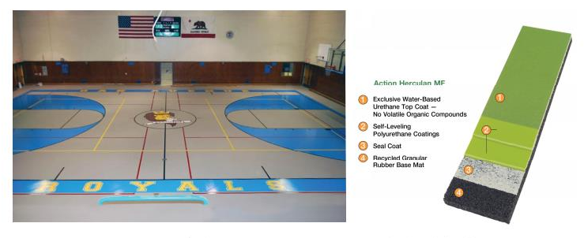
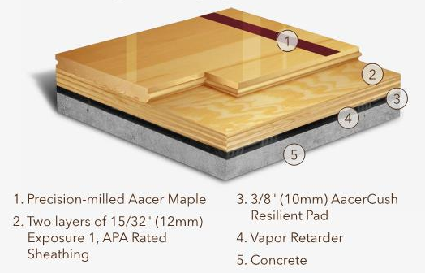
Design Update
Potential Add Alternate
Gym Floor – approximate value $190k
Base bid would include a synthetic sports floor. The Add Alternate replaces a poured synthetic with a floating wood sports floor.
  Wood Floor in lieu of Synthetic

Slide 9
Design Update
Potential Add Alternates
Town Green Enhancements – approximate value $250k
  Oval asphalt walk and connecting walks to building
  Concrete pavement adjacent to existing bandstand
  Benches (4) on concrete pads
  Site lighting poles (7) and power
  Irrigation
  Plantings (trees and shrubs)
Kitchen Equipment – approximate value $175k
  Kitchen Equipment
Wood Floor – approximate value $190k
  Wood Floor in lieu of Synthetic

