Slide 1
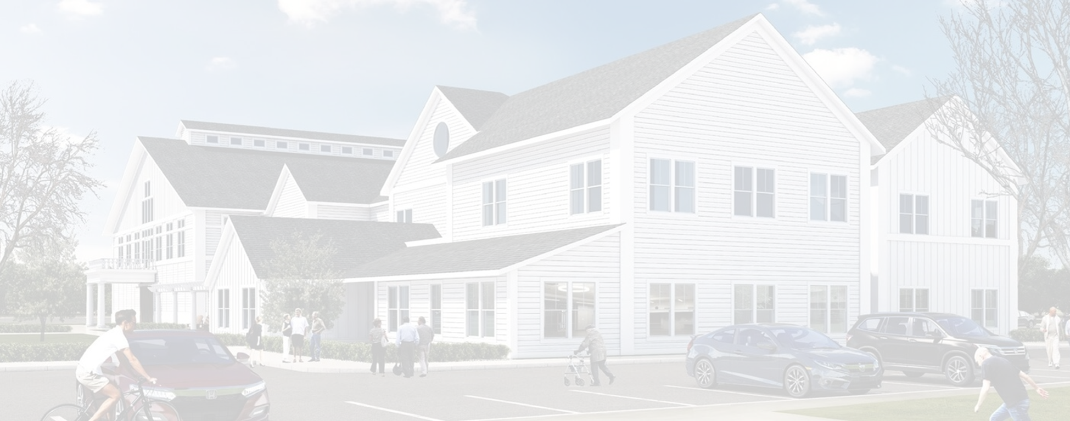
TOWN OF PEMBROKE
NEW COMMUNITY CENTER
Project Update | September 8, 2022

Slide 2
Pre-qualification Process
Per MA General Law:
Use Filed Subcontractor Bidding process
Acoustical Tile, Electrical, Elevator, Fire Protection, Heating, ventilation, and air conditioning, Masonry, Misc. Metal and Iron, Painting, Plumbing, Resilient Flooring, Roofing, Tile, Waterproofing
Filed subcontractor and General Contractor must be certified with the Division of Capital Asset Management and Maintenance (DCAMM)
Project Cost is over $10M, must pre-qualify General Contractors and Subcontractors
Pre-qualified over ninety (90) contractors between GCs and Filed Subs
Filed sub bids were received on 8/11/22
Pre-qualified seven (7) GCs. Five (5) pulled the bid docs. Two (2) bids were received.
Within $100K of each other
G&R Construction: low bid at $18.36M M. O’Connor Construction: $18.42M

Slide 3
Project Schedule Update
General Bids Received August 31
Finalize Overall Budget with Low GC Bid: September 7
Public Outreach with Project Updates: September 8
Town Meeting to Vote on Overall Project Cost: October 18
Award Contract mid/late October
Start Abatement / Demo: November 2022
Start New Construction: February 2023
Construction Complete (16 mos. w/ abate & demo) March 2024

Slide 4
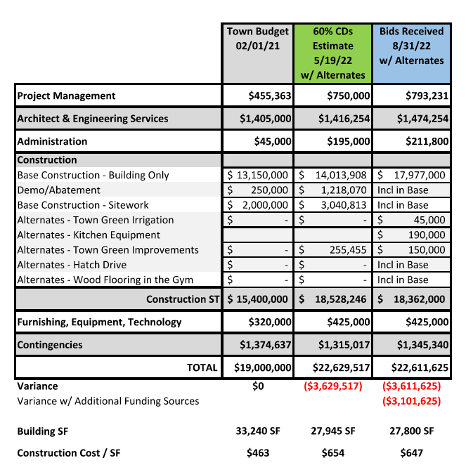
Project Budget Update
Construction Market $/SF:
Senior Centers/Town Halls: $575-675/SF
School Construction: $600-750/SF
Public Safety Buildings: $650-760/SF
Market cost increases due to increase in steel; roofing; and MEP costs. All other costs level.
Total cost variance based on $19M Appropriation
Request for Additional Funding; Total cost variance based on $19M Appropriation + Additional $310K ARPA Funding + Additional $200K Mass 2021 Earmark

